Slide 1
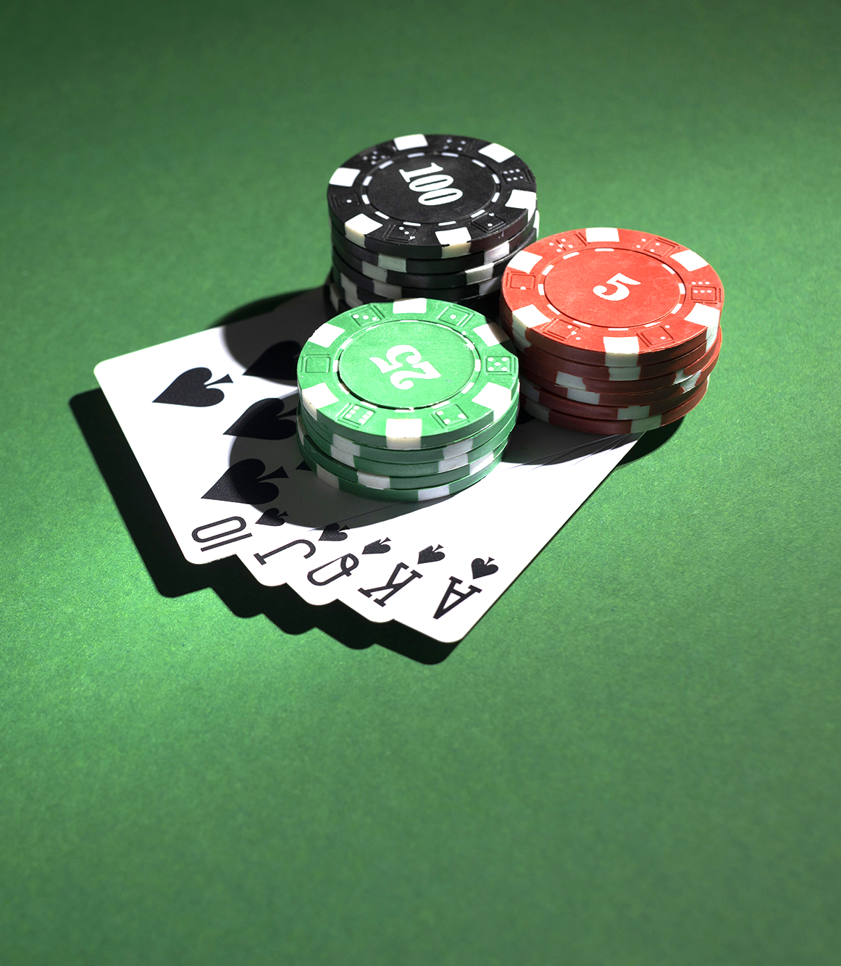
Develop a Poker Game Simulator with Expectiminimax
Group – 7
Group Members:
Md Simanto Haider 2021211042
Md Tajul Islam 2031210642
Sheikh Mushrure Zucky 1821178642
Md Taibur Rahaman 1931424642

Slide 2
Introduction
Our project focuses on using artificial intelligence to solve one of the most complex problems in game theory: poker.
We've developed a Texas Hold'em simulator where an AI agent makes strategic decisions.
The AI uses a powerful algorithm called Expectiminimax.
The goal is to explore how AI can navigate games with incomplete information and stochastic events.
Group – 7
Group Members:
Md Simanto Haider 2021211042
Md Tajul Islam 2031210642
Sheikh Mushrure Zucky 1821178642
Md Taibur Rahaman 1931424642

Slide 3
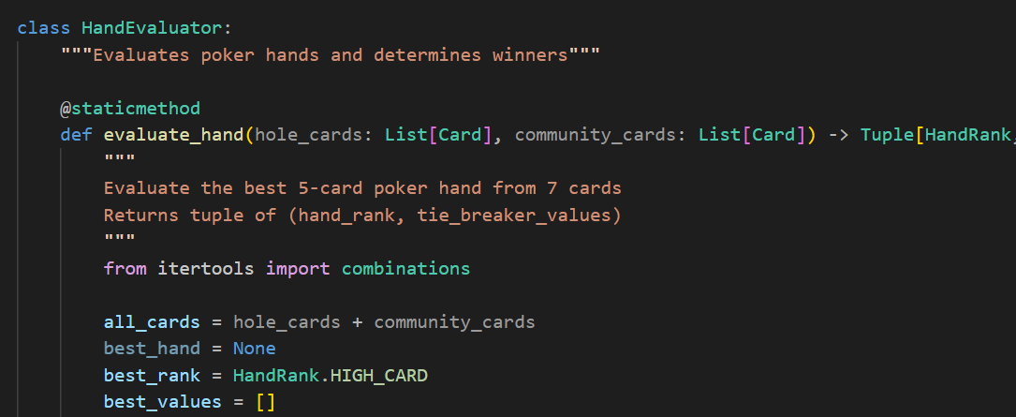
Game logic
The Hand Evaluator: Game's Core
Purpose: Algorithm to find the best 5-card poker hand from 7 cards.
Method: Checks all 21 possible 5-card combinations against poker's hand rankings.
Output: Winning hand rank and tie-breaker values.
Why it Matters: The definitive rule-set for determining every winner. Essential for AI decision-making.
Group – 7
Group Members:
Md Simanto Haider 2021211042
Md Tajul Islam 2031210642
Sheikh Mushrure Zucky 1821178642
Md Taibur Rahaman 1931424642

Slide 4
The Expectiminimax Algorithm
Problem: Minimax cannot handle the randomness in poker.
Solution: Use the Expectiminimax algorithm, an extension of Minimax.
Minimax Overview:
Builds a decision tree assuming the opponent always plays perfectly.
Chooses moves to minimize the worst-case loss.
Great for games with perfect information like chess.
Why Poker is Different:
Cards are random → outcomes aren’t fully predictable.
Expectiminimax Advantage:
Adds Chance Nodes to the decision tree.
Minimax Nodes: Player turns → pick moves maximizing expected gain.
Chance Nodes: Random events → compute weighted average of all possibilities.
Example: Flop has 1,755 possible 3-card combinations → calculate expected value for each → average them.
Impact: The AI can make smart decisions even under uncertainty, perfect for poker strategy.
Group – 7
Group Members:
Md Simanto Haider 2021211042
Md Tajul Islam 2031210642
Sheikh Mushrure Zucky 1821178642
Md Taibur Rahaman 1931424642

Slide 5
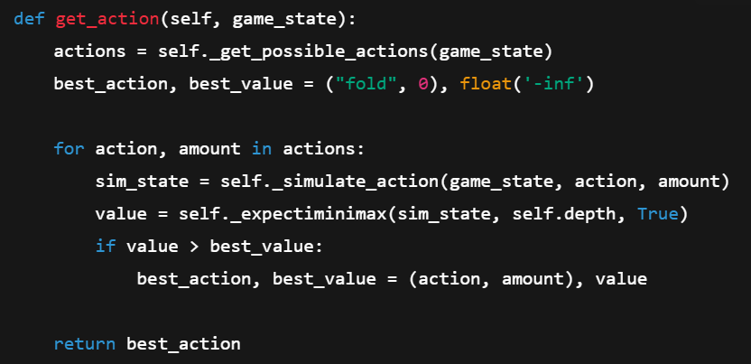
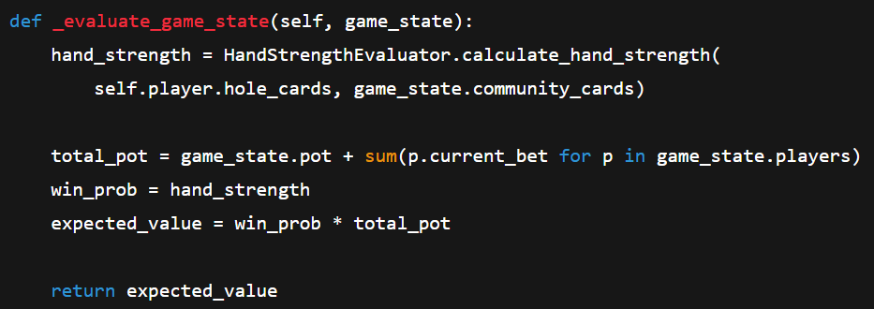
How Expectiminimax Works in Our Simulator
Group – 7
Group Members:
Md Simanto Haider 2021211042
Md Tajul Islam 2031210642
Sheikh Mushrure Zucky 1821178642
Md Taibur Rahaman 1931424642

Slide 6
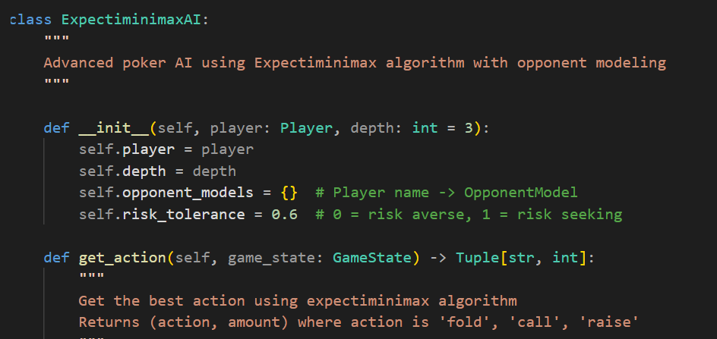
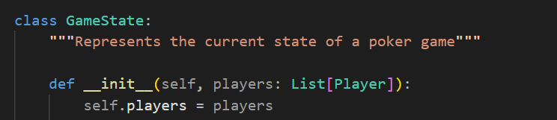
Implementation Details
The simulator was developed in Python.
Our poker application has two main parts:
The Game World (game_logic.py): The rules, the cards.
The AI Mind (expectiminimax.py): The strategy maker.
A recursive function implements the Expectiminimax search.
The user interface is text-based.
Group – 7
Group Members:
Md Simanto Haider 2021211042
Md Tajul Islam 2031210642
Sheikh Mushrure Zucky 1821178642
Md Taibur Rahaman 1931424642

Slide 7
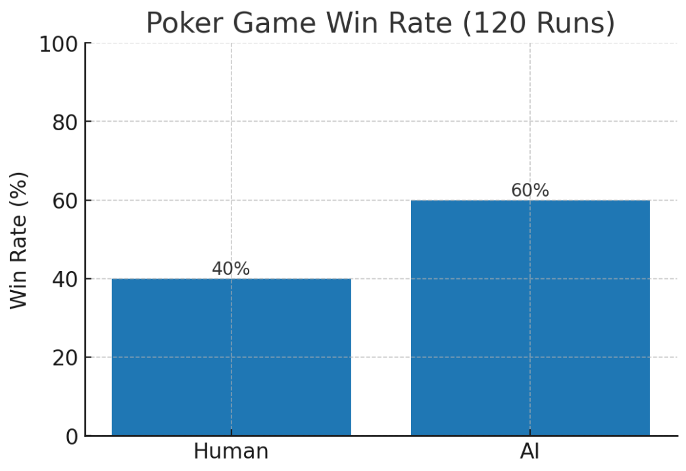
Results and Analysis
Our AI consistently outperformed a simpler, rule-based opponent.
We achieved over a 20% higher win rate in testing.
The AI demonstrated advanced, strategic moves like a calculated bluff, which the algorithm determined was the most probable path to victory.
This validates Expectiminimax as a powerful algorithm for poker AI.
Group – 7
Group Members:
Md Simanto Haider 2021211042
Md Tajul Islam 2031210642
Sheikh Mushrure Zucky 1821178642
Md Taibur Rahaman 1931424642

Slide 8
Future Work
Implement Alpha-Beta Pruning to improve efficiency.
Integrate Opponent Modeling to predict player styles.
Explore Reinforcement Learning to enable the AI to learn from experience.
Group – 7
Group Members:
Md Simanto Haider 2021211042
Md Tajul Islam 2031210642
Sheikh Mushrure Zucky 1821178642
Md Taibur Rahaman 1931424642

Slide 9
Conclusion
We successfully applied a sophisticated algorithm to a difficult, real-world problem.
Our project demonstrates that an AI can make excellent strategic decisions under uncertainty.
This is a strong example of combining classic AI search with probabilistic thinking.
Group – 7
Group Members:
Md Simanto Haider 2021211042
Md Tajul Islam 2031210642
Sheikh Mushrure Zucky 1821178642
Md Taibur Rahaman 1931424642

Slide 10

Thank you
Group – 7
Group Members:
Md Simanto Haider 2021211042
Md Tajul Islam 2031210642
Sheikh Mushrure Zucky 1821178642
Md Taibur Rahaman 1931424642

